Slide 1

Literature
Rosa Maessen

Slide 2
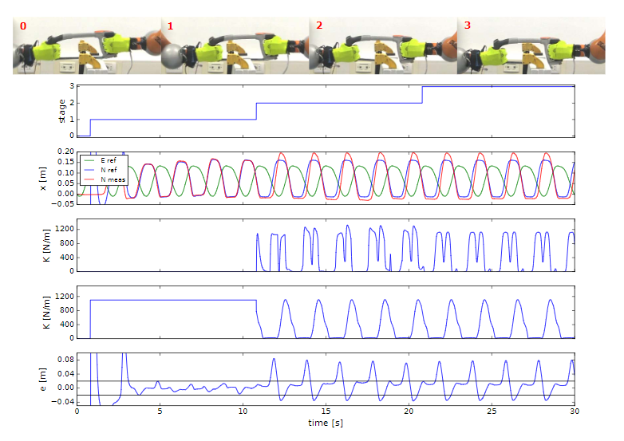
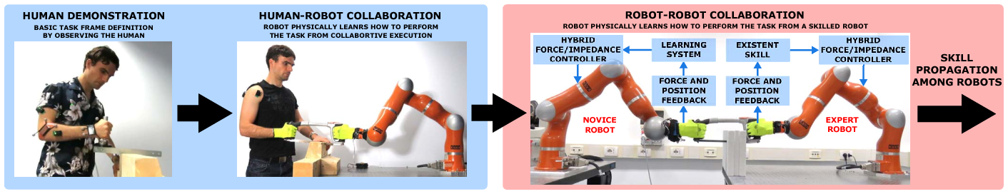
Topic
Peternel, L., & Ajoudani, A. (2017, November). Robots learning from robots: A proof of concept study for co-manipulation tasks. In 2017 IEEE-RAS 17th International Conference on Humanoid Robotics (Humanoids) (pp. 484-490). IEEE.

Slide 3
Research question
“How do methods, found in literature, enable continuous skill learning during collaboration with experts, and how does the learned skill change during the learning process?”

Slide 4
Structure Literature
Introduction
Skill Learning Methods
Markov Decision Process
Imitation Learning
Reinforcement Learning
Summary
Continuous Skill Learning
State Input
Reinforcement Learning
Summary
Discussion
Conclusion

Slide 5
Chapter 2: Skill Learning Methods
Imitation Learning
Behavioural Cloning
DMP, ProMP, HMM, GMM/GMR, GP
Inverse Reinforcement Learning
Max Margin, Maximum Entropy
Reinforcement Learning
Value Function
Monte Carlo, TD, Dynamic Programming
Policy Search
Policy Gradient, Expectation Maximization, Information-Theoretic Insights
Actor-critic
Class of PG Methods

Slide 6
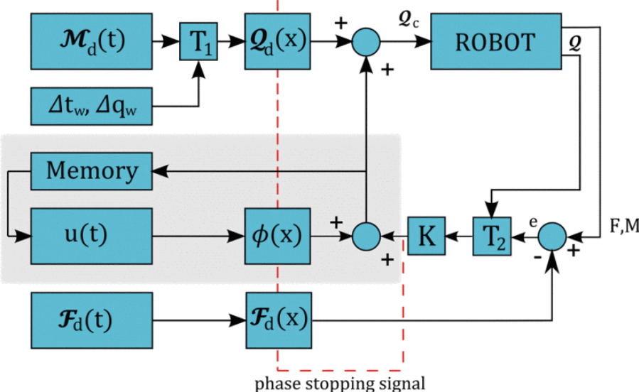
Chapter 3: Continuous Skill Learning
Based on state input
Position, Joint Angle, Force, Torque
Reinforcement Learning

